Slide 1
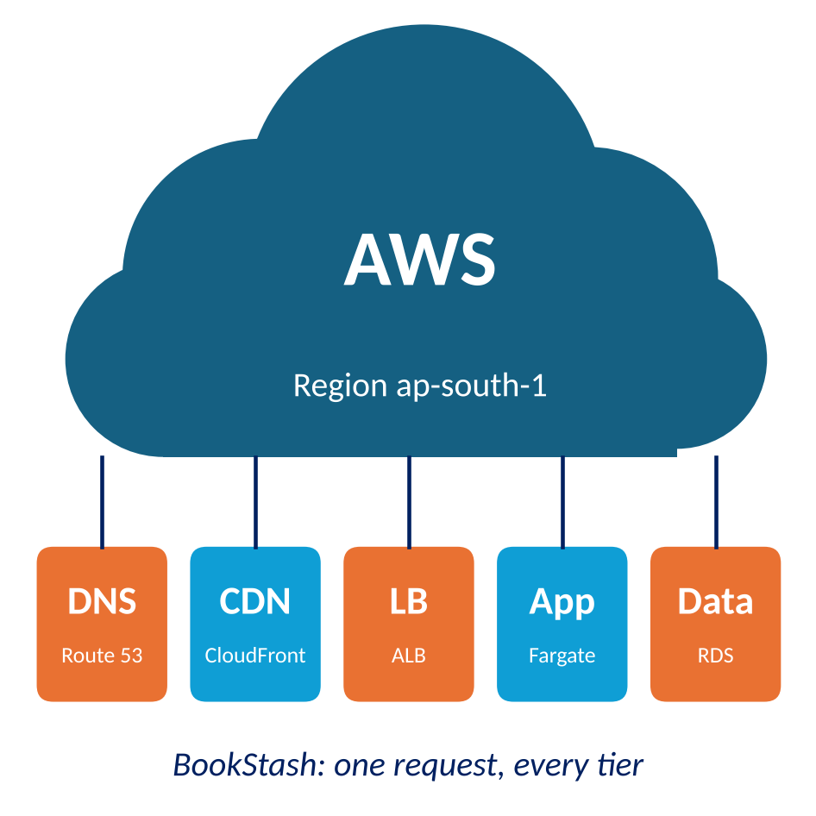

CO 1: The Cloud System as a Whole
Cloud Infrastructure and Services
25CS2206E
Notes:
Course Outcome CO1. This chapter treats a cloud system as one working whole: we observe the deployed BookStash application on AWS end to end before studying any single service.

Slide 2
Chapter 1 Index
1.1
A Working Multi-Tier Cloud Application
1.2
Canonical Cloud-Native Architecture
1.3
Cloud Service Models
1.4
The Shared Responsibility Model
1.5
AWS, Azure and GCP Compared
1.6
End-to-End Request Tracing
1.7
AWS Global Infrastructure
1.8
Course Scope and Boundaries
Learning Objectives
Chapter Summary
Self-Test
Hands-On Lab 1
Select a tile to jump to that part of the chapter. Every slide has a link back to this index.
Notes:
Chapter index. Each tile links to the first slide of a section; the link at the bottom right of every content slide returns here.

Slide 3
Learning Objectives
Describe BookStash and trace a request from browser to database and back
Map AWS services to their closest Azure and Google Cloud equivalents
1
5
Name each tier of the canonical cloud-native architecture and its AWS service
Read an X-Ray trace and find the evidence each hop leaves behind
2
6
Distinguish IaaS, PaaS, SaaS, FaaS and CaaS by what the customer still manages
Explain Regions, AZs and edge locations as nested failure domains
3
7
Apply the shared responsibility model to security and reliability
State what this course covers and what CICD and SDSR cover
4
8
back to chapter index
Notes:
By the end of the chapter students should be able to do each of these eight things. We return to them in the summary.

Slide 4
1.1 A Working Multi-Tier Cloud Application
BookStash is an online catalogue and ordering service for a university bookstore, deployed on AWS in ap-south-1 (Mumbai).
Static content
Operation | Method | Behaviour
/api/books/{id} | GET | One book as JSON; read-heavy, cacheable
/api/search?q= | GET | Search titles and authors in the database
/covers/{id}.jpg | GET | Cover image; cached at the edge for a day
/api/orders | POST | Queues the order; returns 202 Accepted
/api/stock/{id} | PUT | Staff stock update; clears cached record
/healthz | GET | Health check for the load balancer
Cover images never change for an ID
Cached at the edge by CloudFront
Repetitive reads
Book lookups repeat thousands of times
Served from ElastiCache in memory
Writes that must not be lost
Orders need follow-up work
Queued in SQS for a worker
back to chapter index
Notes:
We start from a running system, not from definitions. BookStash is an ordinary bookstore catalogue and ordering service; its three kinds of traffic (static images, repetitive reads, writes that must not be lost) are each handled by a different part of the architecture.

Slide 5
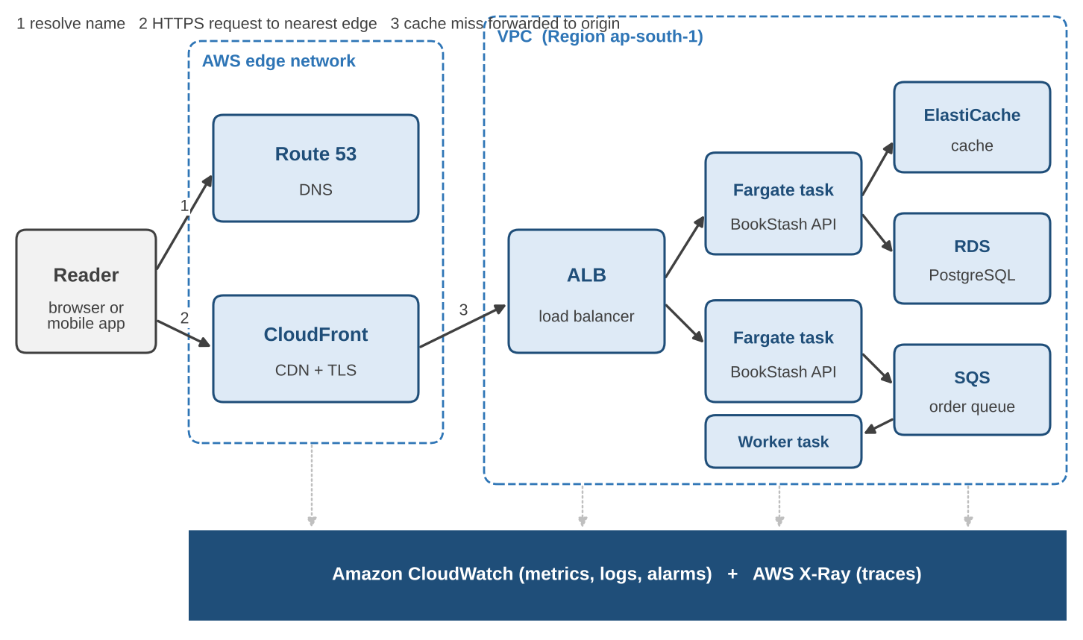
1.1 The Deployed System at a Glance
1
Route 53
resolves bookstash.com to a nearby edge
2
CloudFront
terminates TLS; answers from cache or forwards
3
ALB
picks a healthy API task in any AZ
4
Fargate task
runs the BookStash API container
5
ElastiCache / RDS
cache first, database on a miss
6
SQS + worker
orders processed after the reply
back to chapter index
Notes:
Read the diagram left to right, which is the direction of a request. Edge services sit outside the VPC; the application and data tiers run inside it. CloudWatch and X-Ray observe every tier.

Slide 6
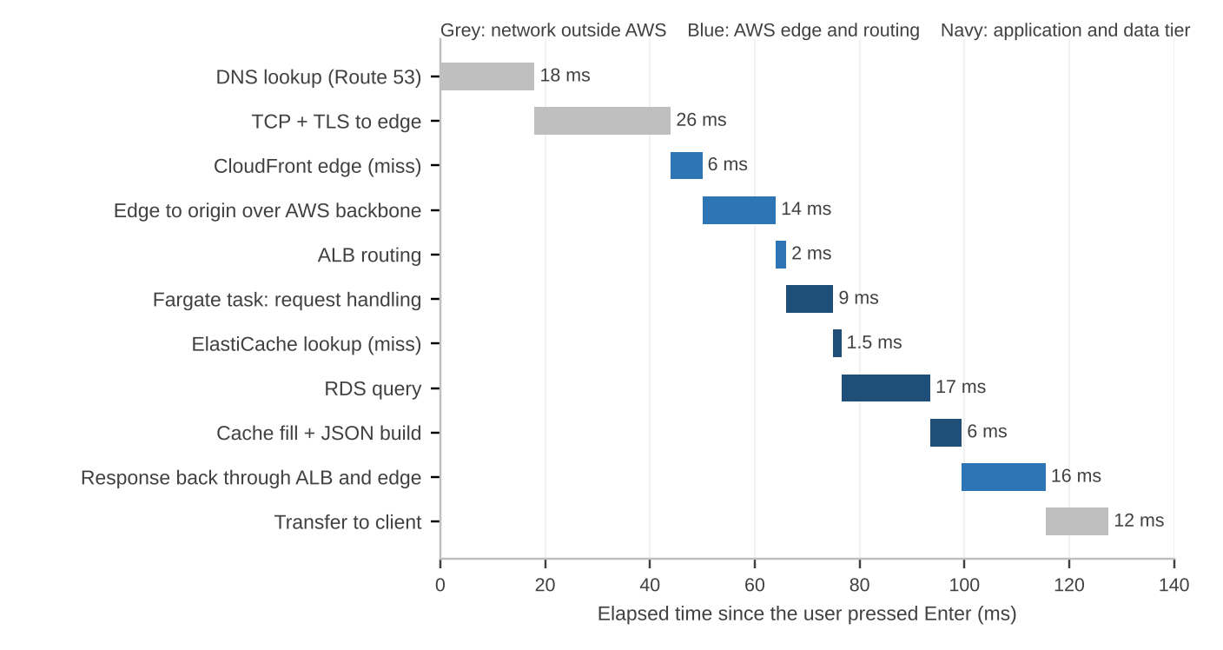
1.1 The Request and Response Round Trip
Before our code
DNS plus TCP and TLS handshakes take about a third of the time. CDNs and connection reuse matter.
Inside our code
The RDS query is the largest single item. Caching pays off.
On the way back
Cold GET /api/books/42 from Hyderabad: about 127 ms end to end.
Response size matters. Smaller or compressed payloads arrive sooner.
back to chapter index
Notes:
This is the slowest normal path: nothing cached at the edge or in ElastiCache. About a third of the time passes before the request reaches our code. Inside the application tier the database query is the largest item, which is why we cache. Values are illustrative.

Slide 7
Example 1.1 A Latency Budget for BookStash
Hop | Budget | Cold | Warm
DNS and connection setup | 50 | 44 | 0 (reused)
Edge and transfer to origin | 30 | 20 | 20
ALB and task handling | 15 | 11 | 11
Cache and database | 60 | 18.5 | 1.5
Response build and return | 45 | 34 | 28
Total (ms) | 200 | 127.5 | 60.5
200 ms
p95 budget from India
127.5 ms
cold path: nothing cached
60.5 ms
warm path: cache hit, reused connection
back to chapter index
Notes:
Target: 200 ms at p95 from India. We budget each hop and compare with measurements. The cache and database line has the largest allowance and the most variance, so that is where we look first if a release breaks the budget.

Slide 8
1.1 Why We Observe the Whole Before the Parts
1
Follow the request
2
Know each boundary
3
Measure before changing
Ask which hop the request was on when time was lost or an error appeared.
Every box has an owner, a failure mode and a limit.
Back every claim with a metric or a trace that anyone can reproduce.
$ dig +short bookstash.com
13.224.163.12
13.224.163.84
$ curl -sI https://bookstash.com/covers/42.jpg
cache-control: public, max-age=86400
age: 5123
x-cache: Hit from cloudfront
x-amz-cf-pop: HYD50-P1
$ curl -s https://bookstash.com/api/books/42 -D -
x-cache: Miss from cloudfront
x-amzn-trace-id: Root=1-6740d8f2-3b9c...
Addresses belong to CloudFront, not to our servers
Cover served from the Hyderabad edge cache, cached for 5,123 s so far
API call missed the edge and reached the origin
Trace ID lets us find this exact request in X-Ray
back to chapter index
Notes:
Production problems rarely sit inside one box; they sit on the arrows between boxes. Three habits follow. The commands show what a terminal alone reveals about each layer: CloudFront addresses, an edge cache hit in Hyderabad, and a trace ID echoed by our API.

Slide 9
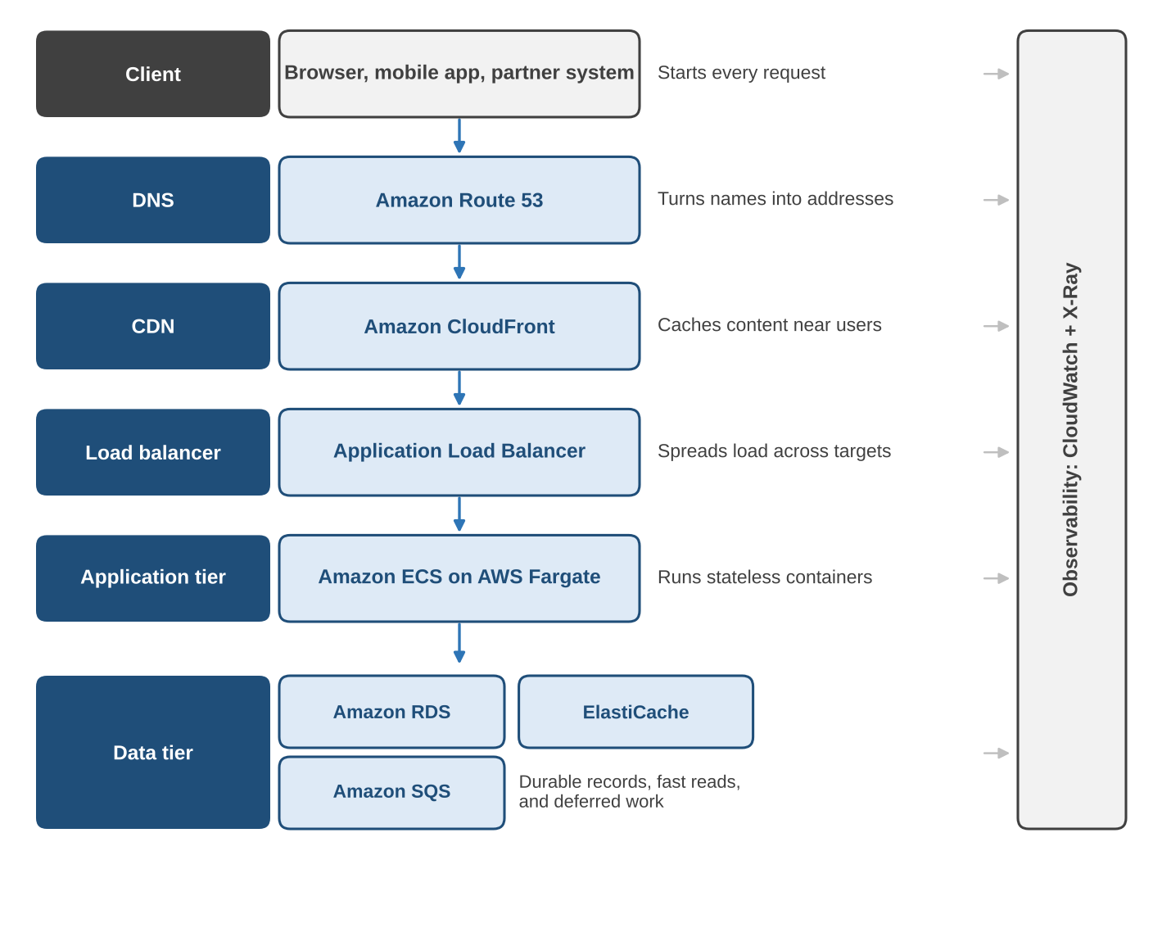
1.2 Canonical Cloud-Native Architecture
Working definition: cloud-native
Stateless processes that can be replaced at any time
Durable state in managed data services, not local disks
Deployed and scaled through declarative configuration
Metrics, logs and traces built in, so nobody logs in to a machine
BookStash meets all four: stateless tasks, data in RDS, ElastiCache and SQS, templates, and CloudWatch plus X-Ray.
back to chapter index
Notes:
A stack of tiers, each with one job, connected by standard protocols. Most web systems on public clouds since the mid-2010s follow it with small variations. Our working definition of cloud-native is narrower than the CNCF one and is something we can check BookStash against.

Slide 10
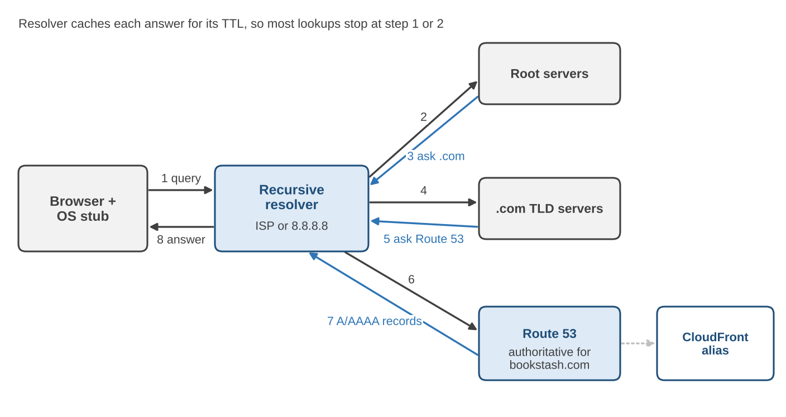
1.2 DNS with Amazon Route 53
Authoritative server
Holds the definitive records for the bookstash.com hosted zone
Alias records
Point the apex name straight at CloudFront; no charge for these queries
Health checks
Change answers based on health, latency, location or weight
Routing policies
TTL tip: lower the TTL to 60 s a day before a planned change, switch, confirm, then raise it again.
Simple
Weighted
Latency
Failover
Geolocation
Multivalue
IP-based
back to chapter index
Notes:
DNS is the first dependency of every request and the slowest thing to change because answers are cached at many levels. Route 53 is the authoritative server for bookstash.com. Alias records point the apex at CloudFront. For planned changes, lower the TTL a day ahead.

Slide 11
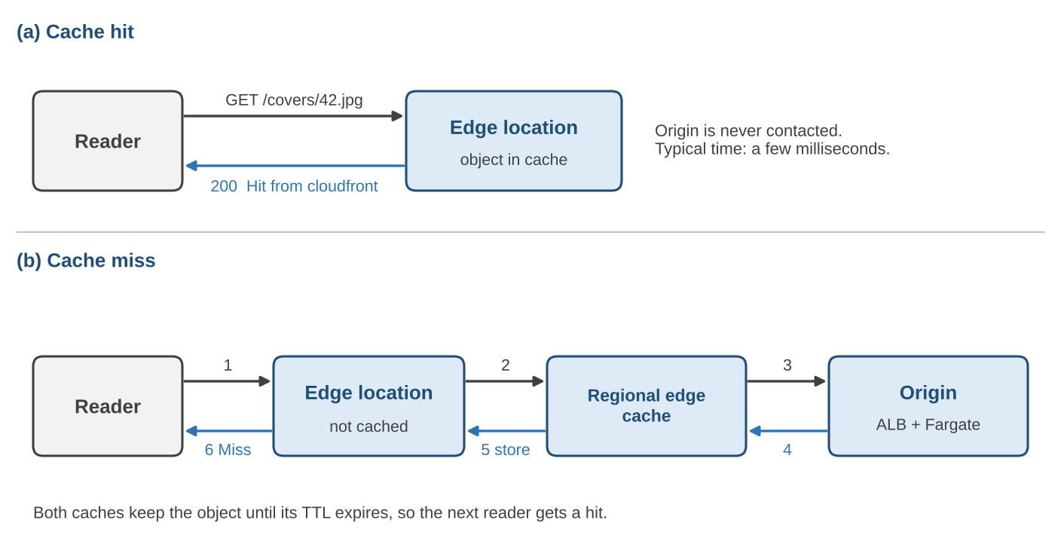
1.2 Content Delivery with Amazon CloudFront
Path | TTL | Notes
/covers/* | 1 day | Never changes per ID
/static/* | 1 year | Hashed bundle names
/api/books/* | 60 s | Stock changes show fast
/api/search* | None | Forwarded to origin
/api/orders | None | POST always forwarded
Beyond caching
TLS handshake completes near the reader
Long-lived, reused connections to the origin
AWS WAF rules and geo restriction at the edge
70%
edge hit ratio on /api/books/*
1.2 M requests a day become 360,000 at the origin.
Peak origin load drops from 55.6 to 16.7 requests per second.
back to chapter index
Notes:
Readers connect to the nearest of several hundred points of presence. A hit is answered at the edge. A miss goes through the regional edge cache to the ALB and fills both caches on the way back. The hit ratio example shows how the CDN cuts origin load.

Slide 12
1.2 The Load Balancer and the Application Tier
Application Load Balancer
API task
AZ a
Layer 7: routes on path, host and headers
Listeners, rules and target groups
Nodes in every enabled AZ
ALB
HTTPS :443
Target group
health check /healthz
API task
AZ b
Amazon ECS on AWS Fargate
Task definition: image, CPU, memory, role
Service keeps the desired task count
Secrets from Secrets Manager; logs to CloudWatch
Health check settings: every 15 s; 2 failures remove a task, 3 successes return it
Health checks that tell the truth: /healthz checks cache and pool connections within 100 ms, but runs no full query.
back to chapter index
Notes:
The ALB is the CloudFront origin and the only way into the VPC. It checks /healthz every 15 seconds. ECS keeps the requested number of tasks running and Fargate runs them without servers we manage. Health checks should be neither too shallow nor too deep.

Slide 13
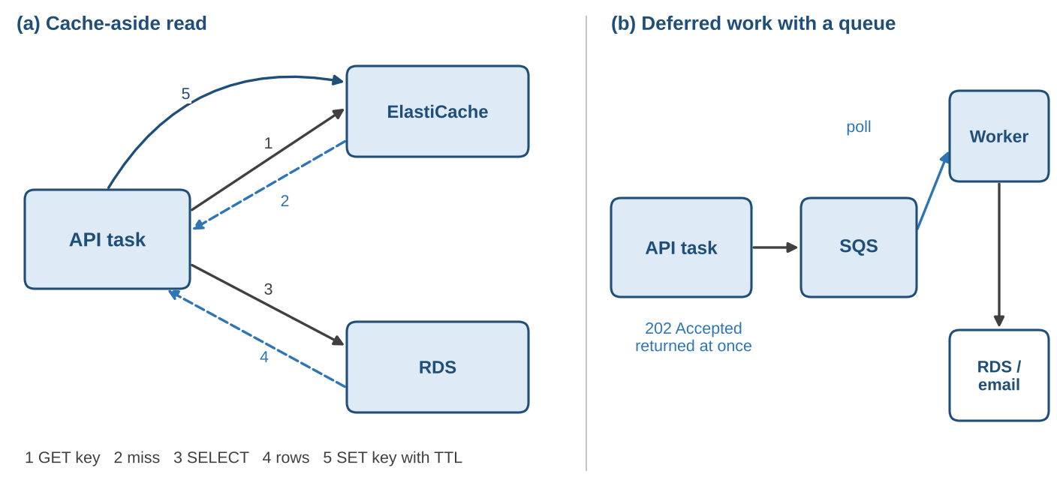
1.2 The Data Tier: RDS, ElastiCache and SQS
Amazon RDS
System of record. Multi-AZ standby, automated backups.
Amazon ElastiCache
Hot data in memory. Sub-millisecond reads.
Amazon SQS
Work buffer. Message kept until the worker deletes it.
If a component fails
RDS down
reads and writes fail; orders wait in the queue
Cache down
slower reads served from RDS
SQS down
new orders cannot be accepted
back to chapter index
Notes:
Stateless tasks are possible because state lives elsewhere. RDS is the system of record. ElastiCache holds hot records using cache-aside. SQS decouples order processing: a crashed worker's message reappears after the visibility timeout.

Slide 14
1.2 Observability with CloudWatch and X-Ray
Metrics
Numbers over time: tell us THAT something is wrong
Logs
Timestamped events: tell us WHAT happened in one component
Traces
One request across tiers: tell us WHERE the time went
Alarm metric | Threshold | Why it matters
ALB TargetResponseTime p95 | > 0.2 s for 5 min | Direct measure of the latency budget
ALB HTTPCode_Target_5XX_Count | > 1% of requests | Application errors seen by readers
ECS RunningTaskCount | < 2 | Loss of redundancy in the API tier
RDS FreeStorageSpace | < 20% | Running out of disk stops writes
SQS ApproximateAgeOfOldestMessage | > 300 s | Worker is not keeping up with orders
ElastiCache CacheHitRate | < 80% for 15 min | Cold cache or wrong keys; database load rises
back to chapter index
Notes:
Metrics tell us something is wrong, logs tell us what happened in one component, traces tell us where the time went. Since February 2026 AWS recommends OpenTelemetry (ADOT) for sending spans to X-Ray; the X-Ray SDKs are in maintenance mode. These are the first alarms we define.

Slide 15
1.3 Cloud Service Models: the NIST Definition
1
2
3
4
5
On-demand self-service
Broad network access
Resource pooling
Rapid elasticity
Measured service
RDS created through the API in minutes
Readers use browsers and phones
Fargate tasks share hosts with other customers
ECS adds tasks above 60% CPU
Billed per vCPU-second and per request
Service models (NIST, 2011)
Deployment models
IaaS
PaaS
SaaS
Private
Community
FaaS
CaaS
added by industry since 2011
Public (BookStash)
Hybrid
back to chapter index
Notes:
NIST SP 800-145 (2011) defines cloud computing through five essential characteristics, three service models and four deployment models. Each characteristic has a direct BookStash example. FaaS and CaaS were added by industry later.

Slide 16
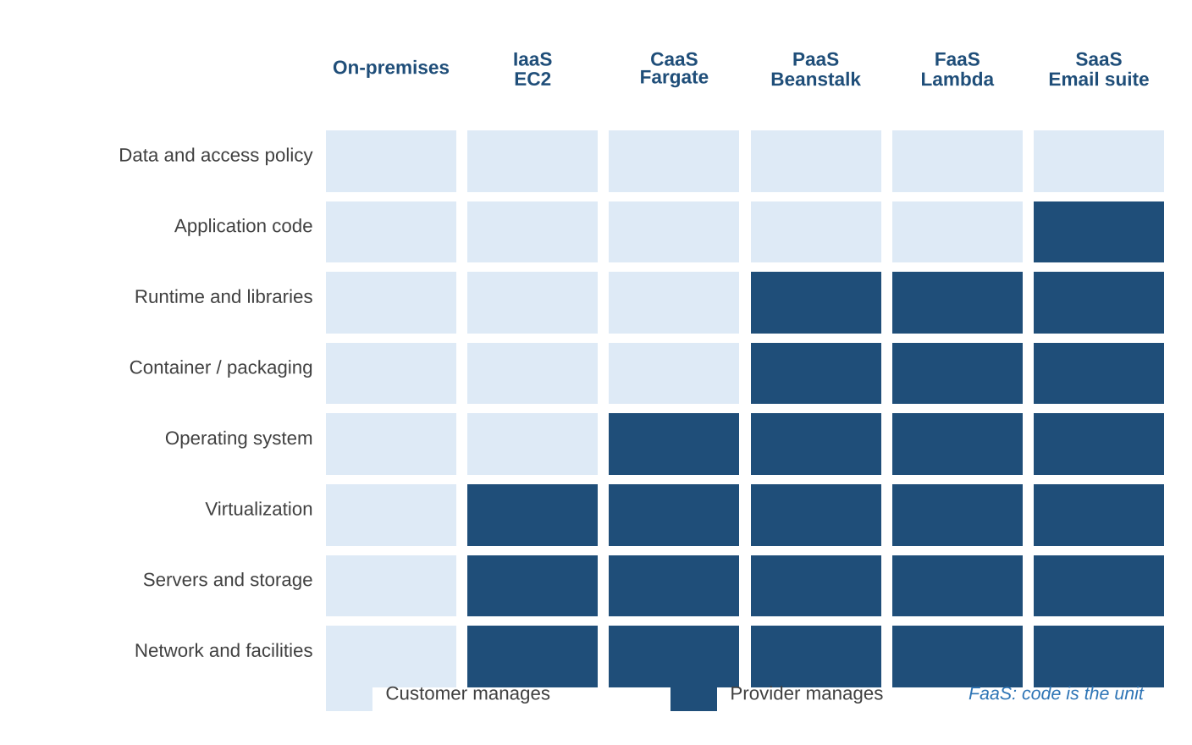
1.3 Who Manages What in Each Model
Reading the stack
IaaS (EC2): you patch the OS, install runtimes and scale machines
CaaS (Fargate): you own the image; AWS owns the hosts
PaaS (Beanstalk): you supply code and configuration
FaaS (Lambda): the function is the unit; scales to zero
SaaS: you configure users and data only
back to chapter index
Notes:
Read each column from the bottom. The provider always runs facilities and hardware. Moving right, more layers become the provider's job. The customer always owns data and access policy, even in SaaS.

Slide 17
1.3 Five Service Models Side by Side
IaaS
CaaS
PaaS
FaaS
SaaS
Provider runs
VMs, disks, networks
Provider runs
Orchestration and hosts
Provider runs
OS, runtime, scaling
Provider runs
Everything but the function
Provider runs
Whole application
You manage
OS upwards
You manage
Container image
You manage
Code and config
You manage
Function code
You manage
Users and data
Example
Amazon EC2
Example
ECS on Fargate
Example
Elastic Beanstalk
Example
AWS Lambda
Example
Microsoft 365
BookStash
Not used
BookStash
API and worker
BookStash
Not used
BookStash
Cover thumbnails
BookStash
Staff email
back to chapter index
Notes:
IaaS gives the most control and the most work. PaaS gives speed but limits runtimes. SaaS delivers a whole product. FaaS suits short, event-driven work with a 15-minute limit on Lambda. CaaS has become the default for new web services because images are portable.

Slide 18
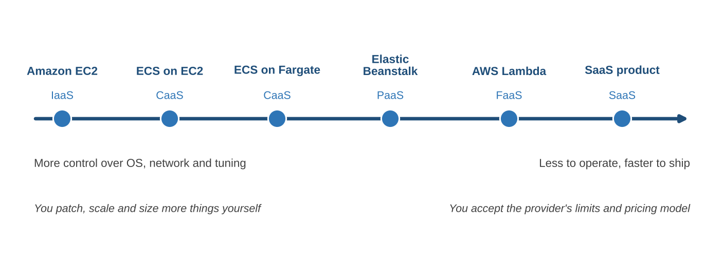
1.3 Abstraction Versus Control
Aspect | IaaS | CaaS | PaaS | FaaS | SaaS
Unit you deploy | VM image | Container image | App code | Function | Config only
Billing basis | Instance-hours | vCPU, memory/s | Instances or plan | Requests, duration | Per user
Startup time | Minutes | Seconds | Seconds to minutes | Milliseconds | None
Portability | High | High | Medium | Low to medium | Low
back to chapter index
Notes:
This is not a ranking. Each step right trades control for less operational work. The right point depends on the workload and the team.

Slide 19
Example 1.5 Choosing a Service Model
Continuous or only on events?
Custom runtime needed?
How much ops effort can we spare?
Feature | Load pattern | Choice | Reason
Book API | Continuous, daily peaks | CaaS: ECS on Fargate | Long-running, connection pools, custom libraries
Cover thumbnails | Bursts when staff upload | FaaS: Lambda | Short, event-driven, idle most of the day
Monthly sales report | Once a month, 20 minutes | FaaS or scheduled task | Lambda if under 15 min; else a scheduled task
When FaaS is not the right fit: 15-minute maximum run, cold starts on new environments and no local state between invocations. Steady high load is usually cheaper on containers.
back to chapter index
Notes:
Three questions decide most cases. The book API runs all day and holds connection pools, so containers. Thumbnails are short and bursty, so functions. The monthly report runs on Lambda if it fits in 15 minutes, otherwise as a scheduled Fargate task.

Slide 20
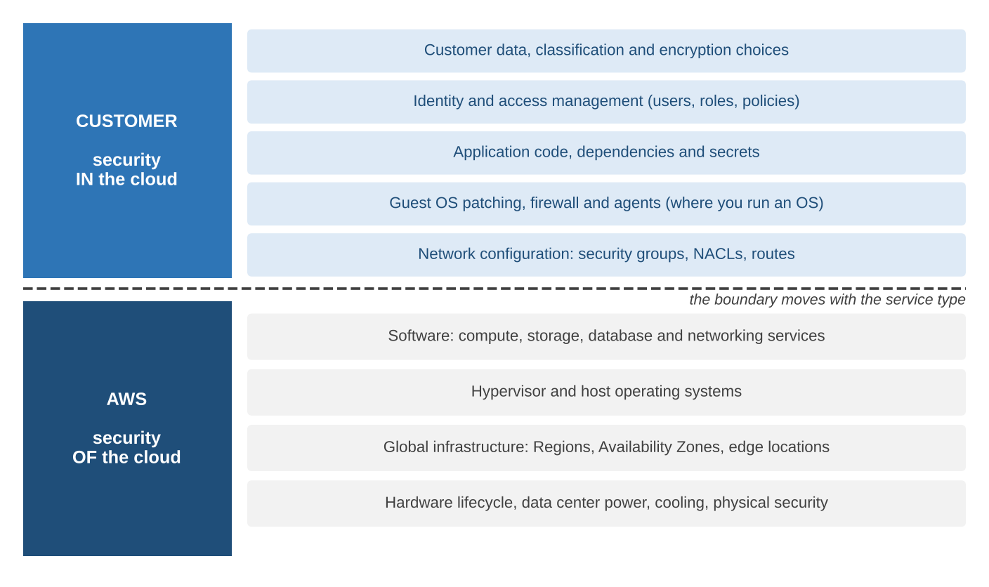
1.4 The Shared Responsibility Model
A simple test for ownership
If a setting can be changed from our AWS account, its consequences are our responsibility.
How AWS shows its side
SOC 1, 2 and 3 reports
ISO/IEC 27001, PCI DSS
Reports in AWS Artifact
SLAs give credits, not guarantees
back to chapter index
Notes:
AWS is responsible for security of the cloud; customers for security in the cloud. AWS proves its side through third-party audits available in AWS Artifact. An SLA is a refund commitment, not a promise that nothing fails, so we design for any component being down for some minutes.

Slide 21
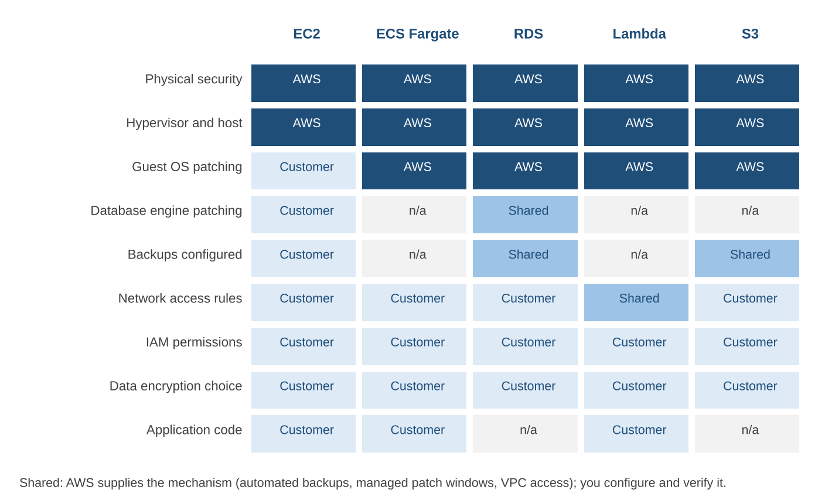
1.4 How the Boundary Moves with the Service
Always AWS
Physical security, hypervisor and hosts
Always the customer
IAM permissions, data classification, encryption choice
Depends on the service
OS and engine patching, backups, network rules
back to chapter index
Notes:
Physical and host security is always AWS's. IAM, data classification and encryption choices are always ours. In between it depends: on EC2 we patch the OS and the database; on RDS AWS patches but we choose the window and approve major upgrades; S3 has nothing to patch but needs policies.

Slide 22
1.4 Security Implications for BookStash
Baseline rule | Risk addressed
Tasks use IAM roles, no long-lived keys | Leaked keys giving permanent access
Least-privilege task roles | One compromised task reaching everything
Data stores in private subnets | Direct internet access to databases
KMS encryption at rest everywhere | Exposure of snapshots or media
TLS on every hop | Interception of data in transit
CloudTrail in all Regions, separate account | Missing or deleted audit evidence
Typical customer-side errors
Storage bucket open to the internet
Access keys in a public repository
Database security group allowing 0.0.0.0/0
IAM policy far broader than needed
back to chapter index
Notes:
Most public cloud incidents are configuration errors on the customer side of the line. We apply these six rules from the first day and revisit each in the security chapter.

Slide 23
1.4 Reliability: Availability of a Chain
ALB
99.99%
API tier
99.95%
ElastiCache
99.9%
RDS
99.95%
99.79%
all four in series (about 91 min/month down)
A = 0.9999 x 0.9995 x 0.999 x 0.9995 = 0.9979
Downtime = (1 - 0.9979) x 30 x 24 x 60 = about 91 min/month
99.89%
cache optional for correctness
Two design choices that help
Cache failure only slows reads, so it leaves the chain: A rises to about 99.89%
Two API tasks in two AZs: tier availability = 1 - (1 - 0.9995)^2, close to 1
~100%
API tier with two independent tasks
back to chapter index
Notes:
AWS owns resiliency of the cloud; we own resiliency in the cloud. Components in series multiply their availabilities. Making the cache optional for correctness removes it from the chain; two API tasks in different AZs make that tier almost never fail. Figures are illustrative.

Slide 24
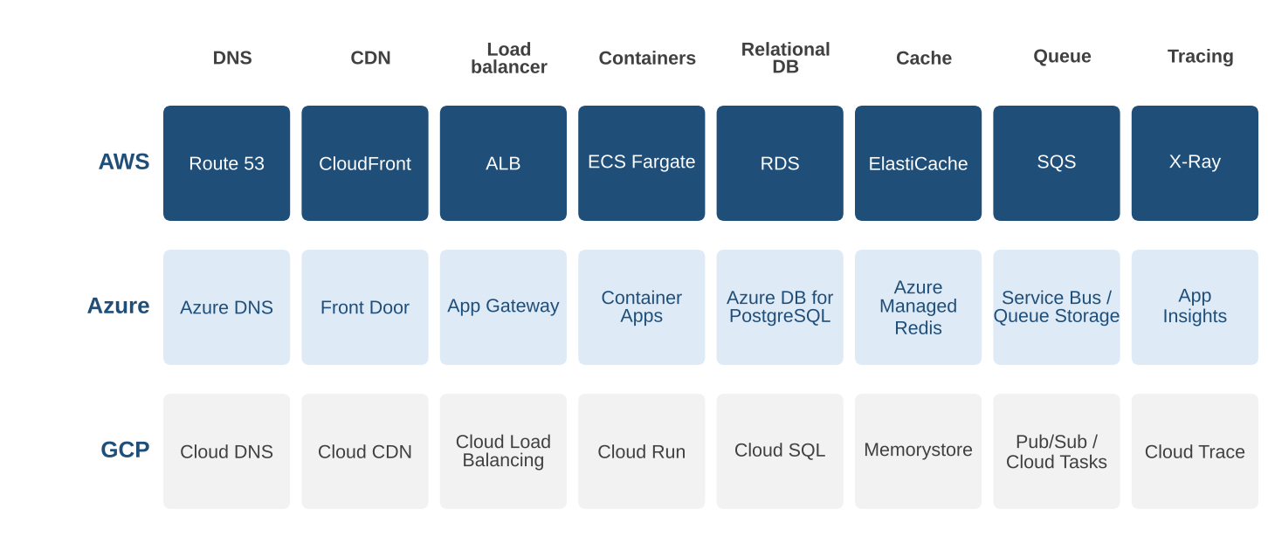
1.5 AWS, Azure and GCP Compared
Edge and LB
Serverless containers
Network scope
Queues
Azure Front Door is both CDN and global L7 balancer
Cloud Run and Container Apps scale to zero
A GCP VPC is global; AWS and Azure are regional
Pub/Sub fans out; Cloud Tasks pushes to HTTP
back to chapter index
Notes:
AWS is our primary platform for breadth, market share and job demand, and for free-tier credits that cover the labs. The concepts transfer: each BookStash tier has a close equivalent on Azure and GCP, with four differences worth knowing.

Slide 25
1.5 Equivalents: Edge, Network and Compute
Capability | AWS | Microsoft Azure | Google Cloud
Authoritative DNS | Route 53 | Azure DNS | Cloud DNS
Content delivery | CloudFront | Azure Front Door | Cloud CDN
Layer-7 load balancer | Application Load Balancer | Application Gateway | Application Load Balancer
Private network | Amazon VPC (regional) | Virtual Network (regional) | VPC network (global)
Virtual machines | Amazon EC2 | Virtual Machines | Compute Engine
Serverless containers | ECS on Fargate | Azure Container Apps | Cloud Run
Managed Kubernetes | Amazon EKS | AKS | GKE
Functions | AWS Lambda | Azure Functions | Cloud Run functions
Platform as a Service | Elastic Beanstalk | Azure App Service | App Engine
Container registry | Amazon ECR | Container Registry | Artifact Registry
back to chapter index
Notes:
These are the closest equivalents, not perfect matches. Limits, pricing and product boundaries always differ in detail.

Slide 26
1.5 Equivalents: Data, Security and Operations
Capability | AWS | Microsoft Azure | Google Cloud
Relational database | RDS, Aurora | Azure Database for PostgreSQL | Cloud SQL, AlloyDB
In-memory cache | ElastiCache | Azure Managed Redis | Memorystore
Message queue | Amazon SQS | Queue Storage, Service Bus | Pub/Sub, Cloud Tasks
Metrics and logs | CloudWatch | Azure Monitor | Cloud Monitoring, Logging
Distributed tracing | AWS X-Ray | Application Insights | Cloud Trace
Isolation unit | Account | Subscription | Project
Identity | IAM, Identity Center | Entra ID, Azure RBAC | Cloud IAM
Secrets | Secrets Manager | Key Vault | Secret Manager
API audit log | CloudTrail | Activity Log | Cloud Audit Logs
Infrastructure as code | CloudFormation, CDK | ARM, Bicep | Infrastructure Manager
back to chapter index
Notes:
The billing and isolation unit differs in name: account, subscription, project. Native infrastructure-as-code tools differ most, which is why porting BookStash to GCP took longest on the templates.

Slide 27
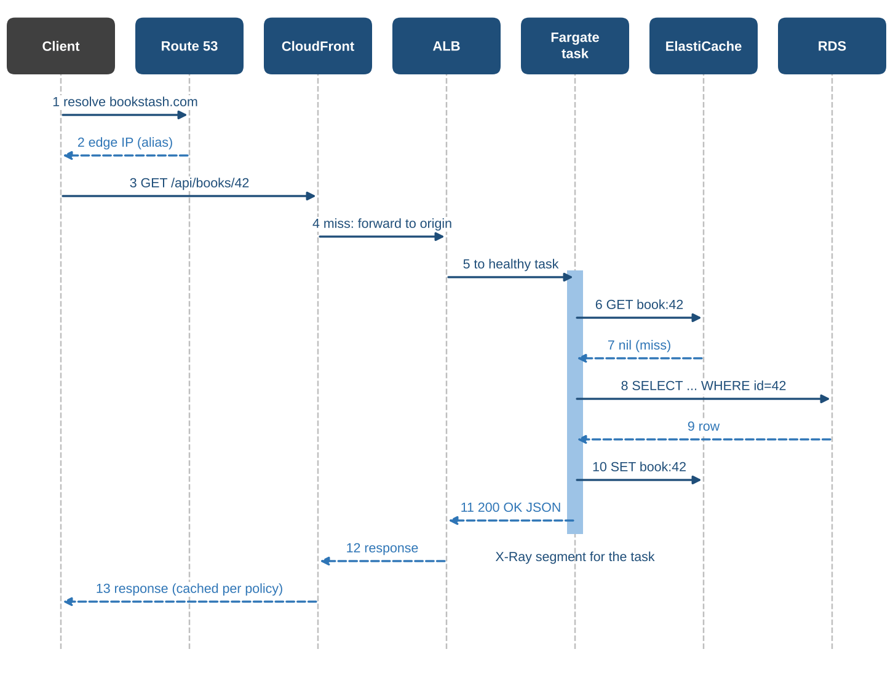
1.6 End-to-End Request Tracing
1
Route 53
Name to edge IP; query logs
2
CloudFront
Miss; forwards to the ALB
3
ALB
Adds X-Amzn-Trace-Id; access logs
4
Fargate task
Root segment for the request
5
ElastiCache, RDS
Subsegments with timings
6
Response
Stored at edge for 60 s
back to chapter index
Notes:
Follow GET /api/books/42 on a cold path. Route 53, CloudFront and the ALB do not emit X-Ray segments; their evidence is in logs and metrics. The ALB adds X-Amzn-Trace-Id, which ties the rest of the trace together.

Slide 28
1.6 Where Each Hop Leaves Evidence
Hop | Primary evidence | What it tells us
Route 53 | Query logs, health check status | Which name was asked, by which resolver, with what answer
CloudFront | Access logs, CacheHitRate, OriginLatency | Hit or miss, edge location, time at edge, origin wait
ALB | Access logs with trace_id, TargetResponseTime | Time waiting for the task, which task, status codes
Fargate task | X-Ray segment, application logs | Time in our code and in each downstream call
ElastiCache | X-Ray subsegment, CloudWatch metrics | Lookup time, hit rate, evictions, memory pressure
RDS | X-Ray subsegment, Performance Insights | Query time, top SQL, waits, connections
SQS | X-Ray subsegment, queue metrics | Enqueue time and backlog age for the consumer
back to chapter index
Notes:
When one hop shows nothing, that absence is itself evidence. The 502 example later is a case where the requests never reached our code.

Slide 29
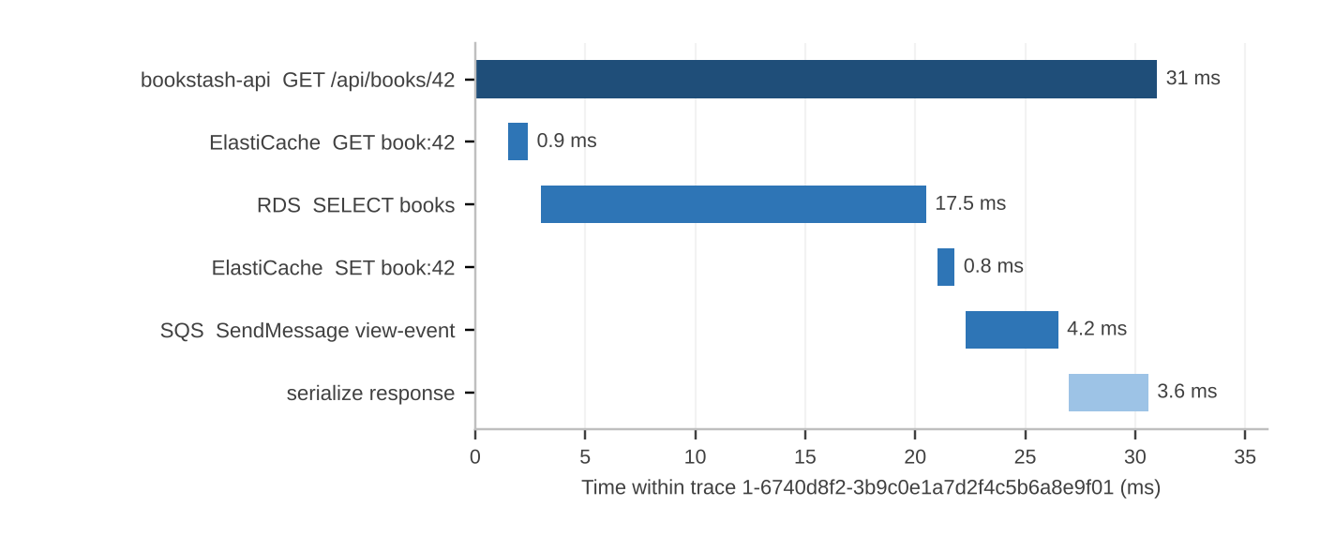
1.6 Reading an X-Ray Trace
Key concept
Trace: one request, all components
Segment: work by one service
Subsegment: a call inside it
Span: OpenTelemetry term for both
Root segment
Small root but slow page: look outside our code
Gaps
Time spent in our own code
~3 traces/s
default sampling at 40 req/s: 1 per second plus 5% of the rest
Longest bar
Start the investigation there
Overlaps
Parallel work shows as overlapping bars
back to chapter index
Notes:
The root segment is 31 ms. If the reader waited much longer, the delay was outside our code. Gaps between bars are our own code. Start with the longest bar: here RDS at 17.5 ms. The service map built from many traces is the first screen to open in an incident.

Slide 30
1.6 Instrumenting BookStash with OpenTelemetry
"command": ["opentelemetry-instrument",
"gunicorn", "app:app"]
OTEL_SERVICE_NAME = bookstash-api
OTEL_PROPAGATORS = xray,tracecontext
OTEL_PYTHON_ID_GENERATOR = xray
OTEL_EXPORTER_OTLP_ENDPOINT = http://localhost:4317
sidecar: aws-otel-collector (ADOT)
Why these settings
X-Ray propagator reads the ALB trace header
X-Ray ID generator makes time-prefixed IDs
Pin the collector version in production
fields @timestamp, @logStream, level, message
| filter trace_id =
"1-6740d8f2-3b9c0e1a7d2f4c5b6a8e9f01"
| sort @timestamp asc
Asynchronous orders
SQS carries the trace in AWSTraceHeader, so the worker's span links to the original request.
back to chapter index
Notes:
The API runs under the OpenTelemetry auto-instrumentation wrapper; a collector sidecar forwards spans to X-Ray. The X-Ray propagator joins our spans to the ALB's trace header. Every log line carries the trace ID, so one Logs Insights query finds the whole request.

Slide 31
Example 1.8 Finding a Slow Query After a Release
1
Alarm
p95 at 410 ms vs 200 ms budget
2
Service map
RDS edge amber at 260 ms
3
Slow trace
One SELECT taking 238 ms
4
Performance Insights
New top query, full scan
5
Fix
Index on lower(title)
410 ms
p95 after release 1.5.0
140 ms
p95 fifteen minutes after the index
Lesson
The service map pointed at the database, the trace named the query, and Performance Insights confirmed the scan.
back to chapter index
Notes:
Release 1.5.0 made search case-insensitive with lower(title) LIKE, which scanned the whole books table. An expression index fixed it. The whole investigation took under twenty minutes using only the evidence sources in this section.

Slide 32
Example 1.9 Explaining a Burst of 502 Errors
ALB metric: Burst of HTTPCode_ELB_502_Count
Cause
1
Tasks were stopped before in-flight connections drained, because the deregistration delay was 5 s and some searches took longer.
2
Application logs: No matching errors
3
X-Ray: No failed traces
Fix
ALB access logs: target_processing_time = -1
Raise deregistration delay to 30 s
Stop accepting new connections on SIGTERM
Absence of evidence at a hop is evidence too
4
5
ECS events: Deployment in the same minute
back to chapter index
Notes:
No application errors and no failed traces meant the requests never reached our code. The ALB logs showed target processing time -1. The cause was a five-second deregistration delay shorter than slow search requests.

Slide 33
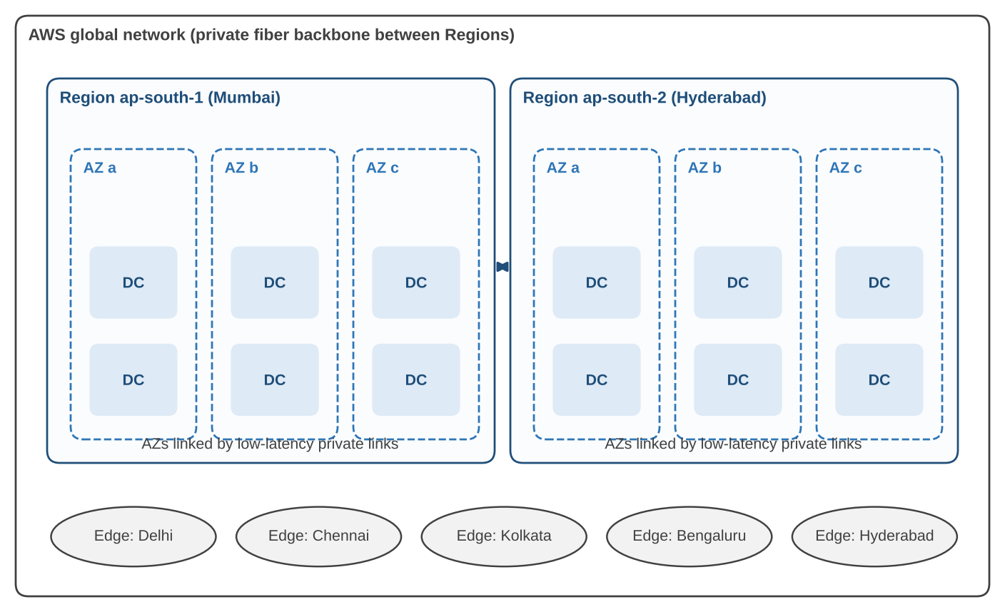
1.7 AWS Global Infrastructure
39
launched Regions
123
Availability Zones
750+
CloudFront PoPs
15
regional edge caches
Choosing a Region
Latency to users (Telangana, Andhra Pradesh)
Data residency: DPDP Act 2023, RBI payment data rules
Every needed service available
Price differs by Region
A recovery Region in the same jurisdiction
back to chapter index
Notes:
Figures are as listed by AWS at the time of writing (late 2026) and grow every year; the structure stays the same. For BookStash we chose ap-south-1 for the primary stack and ap-south-2 for cross-Region backup copies.

Slide 34
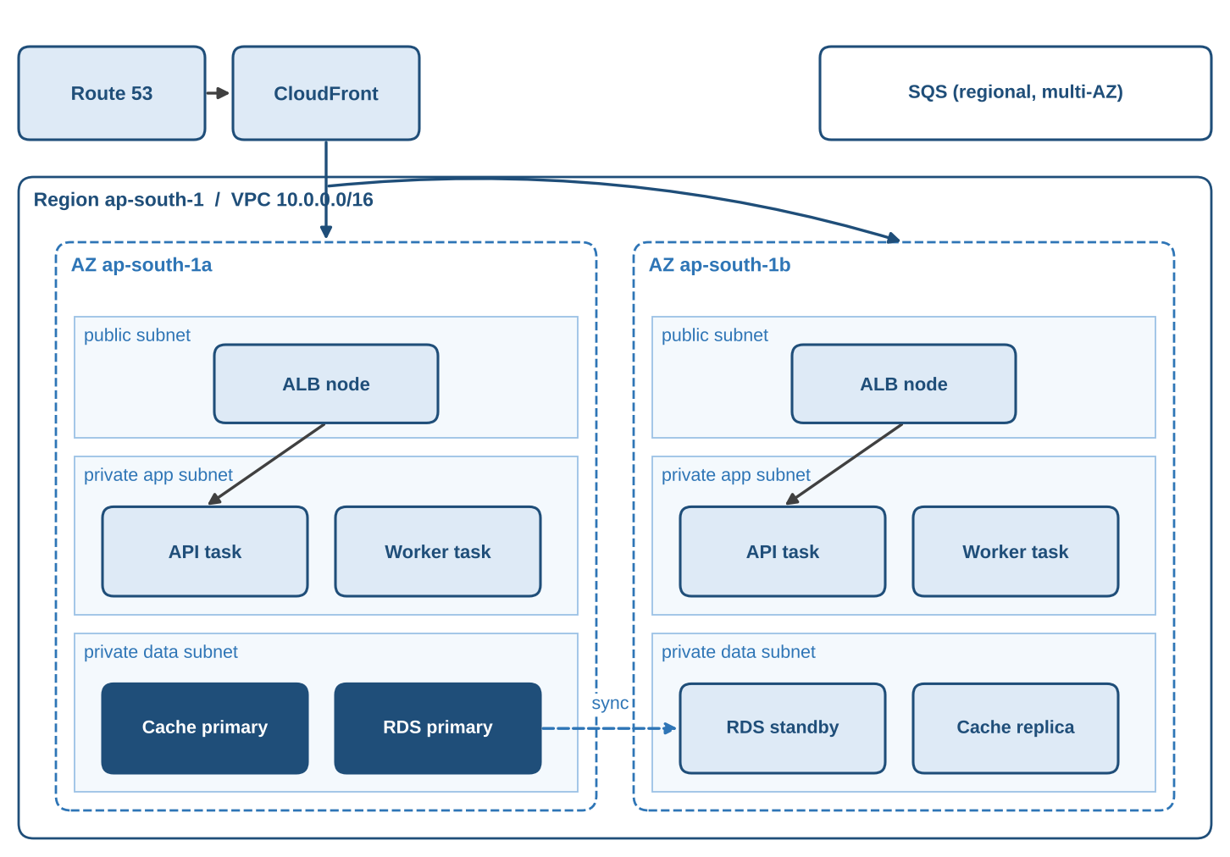
1.7 Availability Zones and the Multi-AZ Layout
If ap-south-1a fails at 14:00
~30 s
ALB stops routing to zone a
1-2 min
RDS promotes the standby in zone b
Minutes
ECS starts replacement tasks
Throughout
CloudFront keeps serving cached pages
Result
Short errors on uncached requests; no queued order lost
back to chapter index
Notes:
An AZ is one or more data centres with independent power and networking, within about 100 km of the others in its Region. AZ letter names map differently per account; AZ IDs such as aps1-az1 are the same everywhere. ALB, SQS and RDS Multi-AZ use AZs automatically; for ECS we choose the subnets.

Slide 35
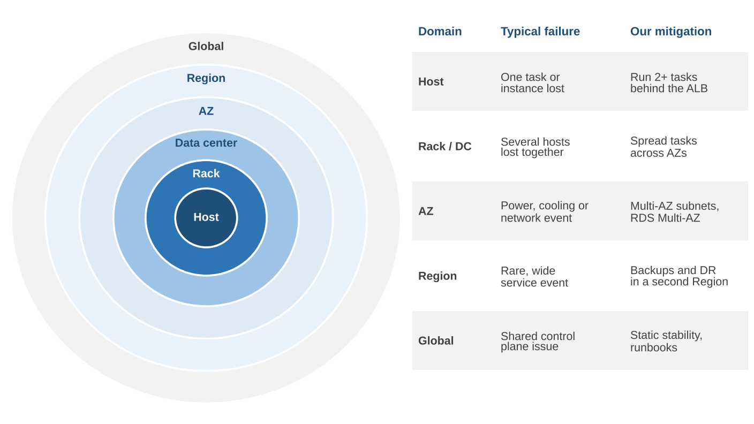
1.7 The Failure-Domain Hierarchy
Spread across the domain to survive
Two tasks in one AZ survive a host failure, not a zone failure
Make the cost explicit
AZ: extra tasks and a standby. Region: a second stack or tested restore
Prefer data planes
IAM and Route 53 changes go through us-east-1; build failover in advance
back to chapter index
Notes:
A failure domain is anything that can fail together because of a shared dependency. We design to survive an AZ automatically. Recovery plans should rely on data planes already in place, such as a Route 53 failover record, rather than control-plane changes during an incident.

Slide 36
1.7 Recovery Objectives and Strategies
Objective | Backup and restore | Pilot light / warm | Active-active
Survives AZ failure | Yes, with Multi-AZ | Yes | Yes
Survives Region failure | After restore | After scale-up | Immediately
Typical RTO | Hours | Tens of minutes | Seconds to minutes
Typical RPO | Last backup | Seconds to minutes | Near zero
Relative cost | Low | Medium | High
BookStash today | Cross-Region copies | Not yet | Not needed
RTO 4 h
time to restore service after a Region failure
RPO 15 min
maximum loss of order data
Tighter objectives and multi-Region designs are covered in SDSR.
back to chapter index
Notes:
The bookstore can live without new orders for half a day but must not lose confirmed orders. That gives RTO 4 hours and RPO 15 minutes, met by point-in-time recovery with snapshots and logs copied to ap-south-2 and a tested rebuild runbook.

Slide 37
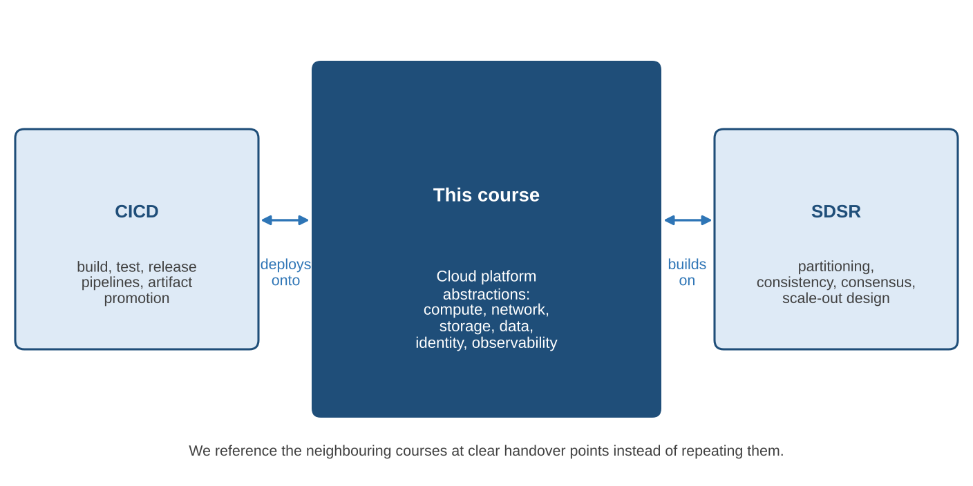
1.8 Course Scope and Boundaries
Topic | This course | CICD | SDSR
VPC and security groups | Primary | Uses | Uses
ECS, Fargate, Lambda | Primary | Deploys | Uses
RDS, ElastiCache, SQS | Primary | Schema | Extends
IAM least privilege | Primary | Pipelines | Uses
Image build and scan | Mentions | Primary | None
Canary deployments | Mentions | Primary | Uses
Sharding, consensus | Mentions | None | Primary
Multi-Region active | Mentions | None | Primary
This course: networking, compute, storage and databases, identity and security, operations
CICD: builds, tests, deployment strategies, IaC pipelines
SDSR: sharding, consistency, consensus, multi-Region
back to chapter index
Notes:
This course covers cloud-platform abstractions: what each hides, guarantees, costs and how it fails. CICD covers how BookStash gets built and released. SDSR covers designs for far larger scale. All three use the same BookStash system.

Slide 38
Chapter Summary
BookStash shows a full request path before any single service is studied
Azure and GCP have close equivalents with differences in LB, containers, networks, queues
1
5
Canonical tiers: client, DNS, CDN, load balancer, app tier, data tier, observability
Tracing follows one request; edges leave logs, our task leaves X-Ray spans
2
6
Service models differ in what the provider runs; customer duties never disappear
Regions, AZs and edges form nested failure domains; we survive an AZ automatically
3
7
AWS secures the cloud; we secure what we build in it. The line moves by service
This course: platform abstractions. CICD: delivery. SDSR: very large scale
4
8
back to chapter index
Notes:
Eight points to take away. Each maps to one learning objective.

Slide 39
Self-Test Questions with Answers
Q1. Why does CloudFront help even on a cache miss?
Q2. Who enables encryption on an RDS instance?
Answer: TCP and TLS handshakes finish at a nearby edge, which reuses long-lived connections to the origin.
Answer: The customer. AWS provides the feature; turning it on is a setting in our account.
Q3. Which hops produce X-Ray spans?
Q4. AZ name versus AZ ID?
Answer: The Fargate task: its segment plus subsegments for ElastiCache, RDS and SQS. Others leave logs and metrics.
Answer: ap-south-1a maps differently per account; aps1-az1 is the same physical zone in every account.
back to chapter index
Notes:
Ask the class each question first, then reveal the answer. Answers come strictly from the chapter.

Slide 40
Hands-On Lab 1: Observing BookStash End to End
1
Resolve bookstash.com with dig; confirm the addresses are CloudFront's
6
Find the request in ALB access logs by trace ID
2
curl -I /covers/42.jpg twice; compare x-cache, x-amz-cf-pop and age
7
List API tasks in ECS; confirm at least two AZs
3
Request /api/books/42 three times; note hits and origin calls
8
Check RDS: Multi-AZ, primary zone, backup retention
4
Open the trace ID in X-Ray; record each subsegment
9
Write the hop-by-hop report with timings
5
Run the Logs Insights query with your trace ID
Outcome: a timed account of one real request and the evidence used for each hop.
back to chapter index
Notes:
Read-only access to the course account, AWS CLI for ap-south-1, dig and curl. The deliverable is a half-page report with a time for every hop that could be measured.

Slide 41

Thank You. Questions?
Next: Chapter 2 takes the first tier of BookStash apart in detail.
Notes:
Close with questions. Remind students to complete Hands-On Lab 1 before the next session.

